Slide 1
Agentic AI
Atul Kahate

Slide 2
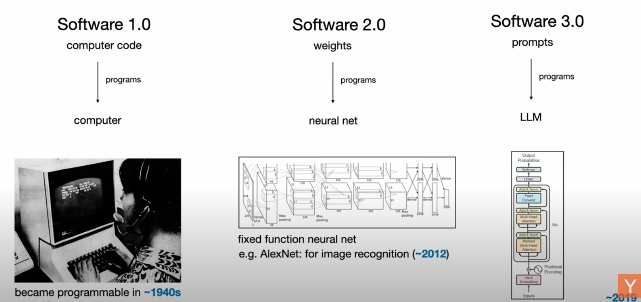
Andrej Karpathy
https://www.youtube.com/watch?v=LCEmiRjPEtQ&t=1693s

Slide 3
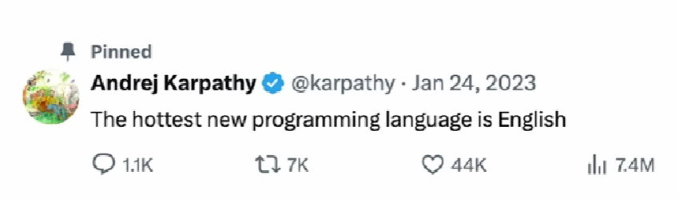
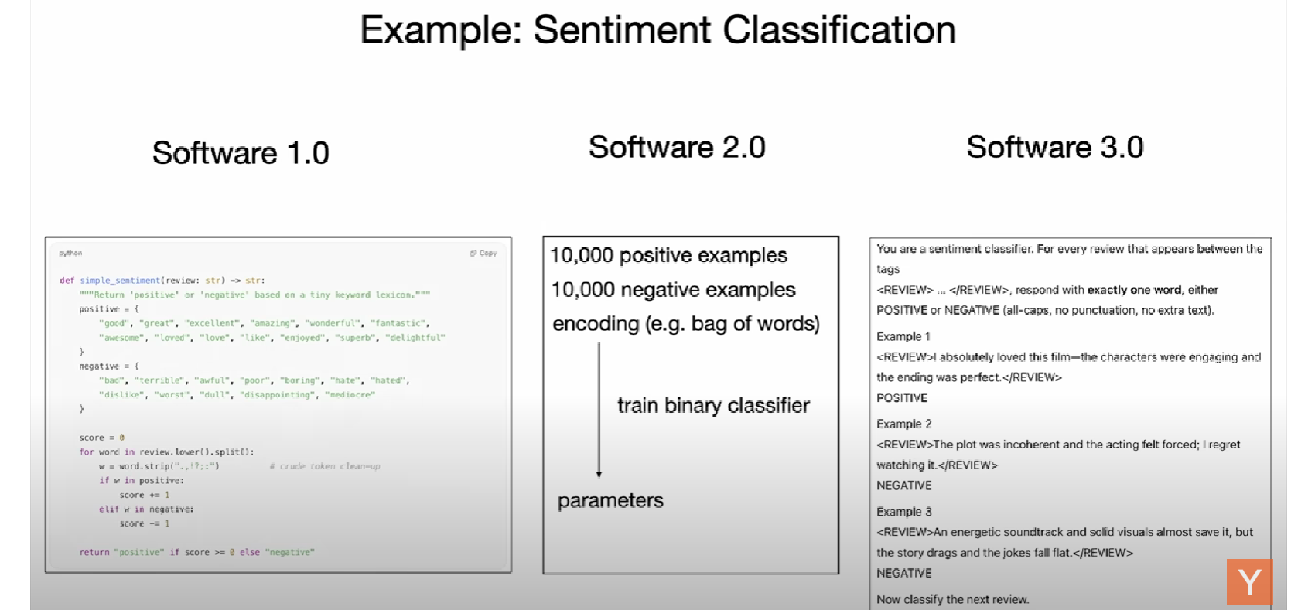
Andrej Karpathy
https://www.youtube.com/watch?v=LCEmiRjPEtQ&t=1693s

Slide 4
Large Language Model (LLM)
Large Language Model (LLM): A type of AI model trained on massive amounts of text data to understand and generate human-like natural language
Examples
GPT-5 (OpenAI)
LLaMA (Meta)
Claude (Anthropic)
Gemini (Google DeepMind)
Mistral (Mistral AI)
Capabilities
Answering questions
Writing essays, code, or articles
Translating languages
Summarizing text
Chatting interactively in natural language

Slide 5

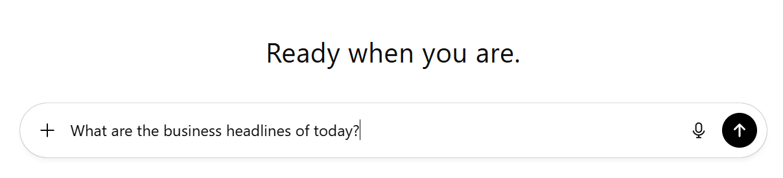

LLM and Tools
An LLM just predicts the next token (word) and it may not have up to date information
But then how can it answer a question such as What are the business headlines of today?
Reason: They run inside an application and have access to tools
AI Application (e.g. ChatGPT)
You are a helpful assistant
You can use the following tools: WEB SEARCH, CALCULATOR, …
LLM
(e.g. GPT-4o)

Slide 6
AI Agent
AI Agent: A system that can perceive its environment, make decisions, and take actions in order to achieve specific goals
Like a software (or robot) that can sense, think, and act—sometimes even learning from experience
Key elements
Capability | Definition | Examples
Perception | Takes input from the environment | Camera images, text, audio, sensor data, user queries
Reasoning / Decision-making | Decides what to do using rules, logic, or machine learning | Choosing the best move in chess, planning a route, selecting a response
Action | Performs tasks based on decisions | Moving a robot arm, answering a question, executing a command
Learning (optional) | Improves performance over time using feedback | Updating chatbot responses, refining recommendations, improving accuracy

Slide 7


Agentic AI
Traditional AI
Agentic AI
Reactive
Proactive
First AI wave: Machines were learning from us
Next wave: Machines are acting for us
Result: Software is not just reactive, but it is proactive
Can take initiatives, make decisions, complete complex workflows seamlessly
Agentic AI: Software that does not wait for the user’s command – It knows its goal
Agentic AI software takes steps to go there
Call API
Pull data
Send email
Write code
Check its own work

Slide 8
Agentic AI Evolution
Artificial Intelligence (AI): Broad umbrella
Any system that mimics human cognitive functions
Rule-based (Old), Self-learning (New)
Machine Learning (ML): Subset of AI
Algorithms that improve through experience, evolve over time without being explicitly reprogrammed
Examples: Spam filters, Recommendation engines, Fraud detection tools
Deep Learning (DL): Special form of ML that uses multi-layer neural networks
Can process massive amounts of unstructured data such as images, videos, and speech
Can understand humans’ natural language
Agentic AI: Adds autonomy, unlike traditional AI, which waits for a human prompt
Traditional AI answers human questions, Agentic AI pursue objectives/solve our problems

